Slide 1

Module 3: Introduction to NumPy
DS 522 Data Acquisition and Analytics

Slide 2
AGENDA
Array-Oriented Programming with Arrays
The NumPy ndarray
Universal Functions
Linear Algebra
Pseudorandom Number Generation

Slide 3
NumPy
short for Numerical Python.
one of the most important foundational packages for numerical computing in Python.
Provides efficient operations on large arrays of data.
NumPy important features:
ndarray - efficient multidimensional array that provides the fast array-oriented computations.
Mathematical functions - fast operations on entire arrays of data without for / while loops.
Linear algebra
Random number generation

Slide 4
The NumPy ndarray

Slide 5
THE NUMPY NDARRAY
ndarray
One main feature of NumPy is its N-dimensional array object
fast, flexible container for large datasets
All the elements are homogeneous
Each array has a shape, a tuple that indicates its dimension (rows, columns).
data.shape
Out: (2,3) → (row, column)
dtype - an object describing the data type of the array.
data.dtype
Out: dtype(‘float64’)
ndarray objects:
‘array’
‘NumPy array’
‘ndarray’

Slide 6
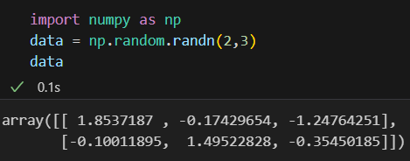
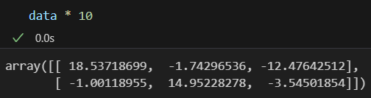
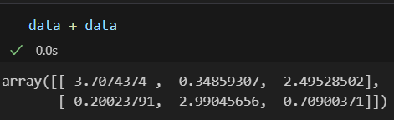
THE NUMPY NDARRAY - Example

Slide 7
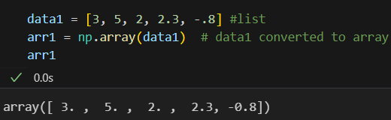
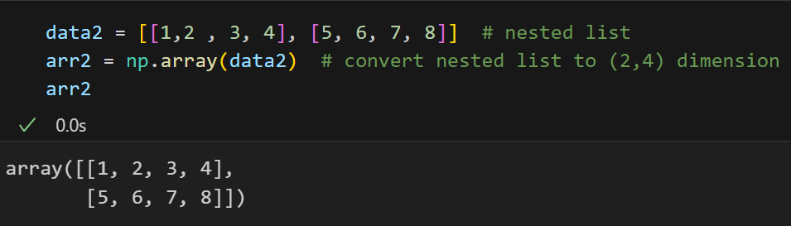
Creating ndarrays
array
function used to create an array.
uses sequence-like objects as inputs
# elements are converted from int to float
Nested sequences will be converted into a multidimensional array:
# elements are not converted

Slide 8
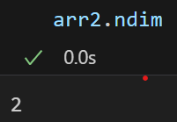
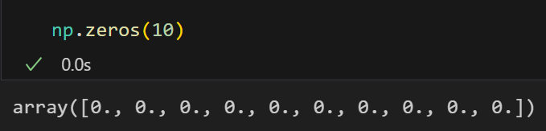
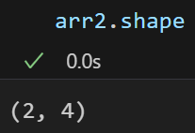
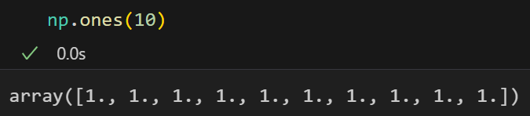
Creating ndarrays
ndim – function to find the dimension of arrays
Output:
shape - function to find the shape of arrays
Output:
zeros() – creates arrays of zeroes
ones() – create arrays of ones are

Slide 9
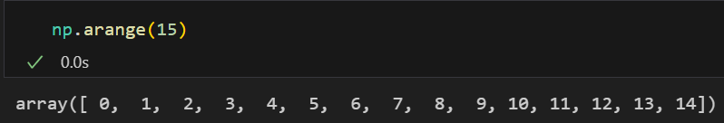
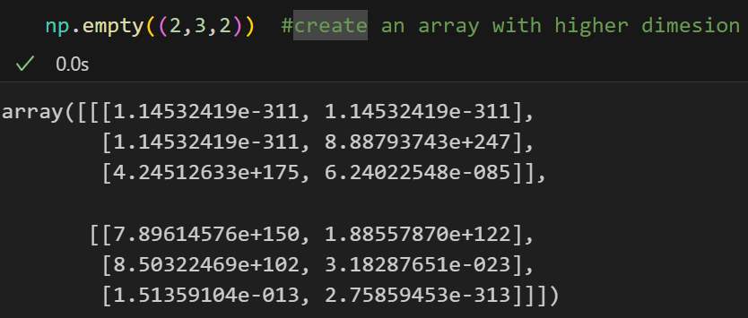
Creating ndarrays
arange() - an array-values version of the range function.
empty() - creates an array without initializing its values.
returns uninitialized, nonzero
“garbage” or random values

Slide 10
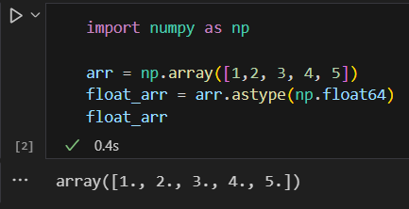
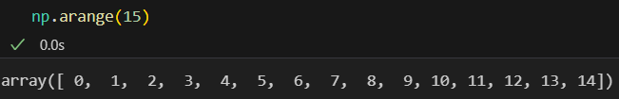
Cast or convert arrays
astype() – convert an array values to different data type
arange() - the array-values version of the range() function.

Slide 11
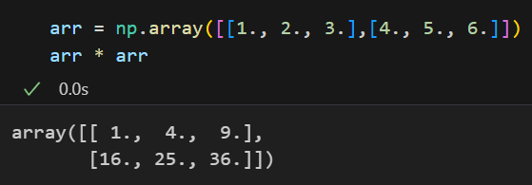
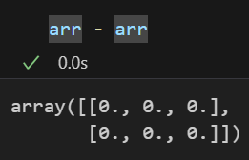
Arithmetic with NumPy Arrays
Any arithmetic operations between equal-size arrays applies the operation element-wise.
> element-wise multiplication
> element-wise subtraction

Slide 12
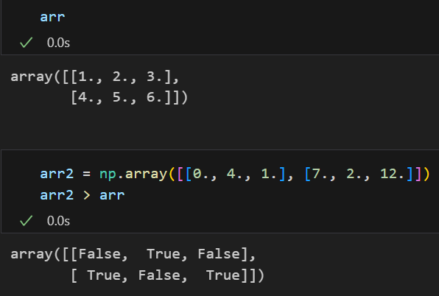
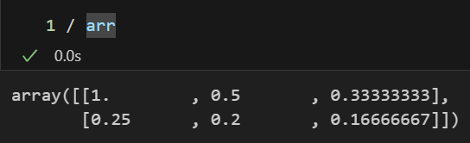
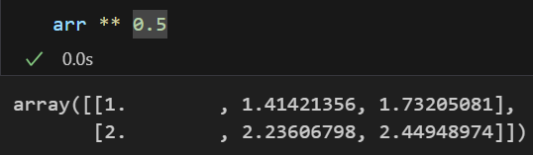
Arithmetic with NumPy Arrays
Arithmetic operations with scalar
> applied to each element in the array
Division
Exponent
Comparison of arrays of the same size > yields boolean arrays

Slide 13
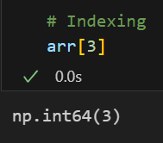
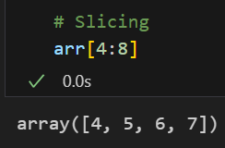
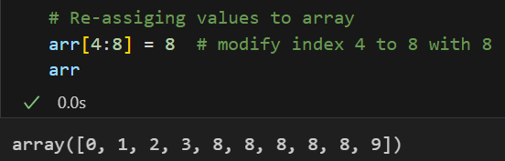
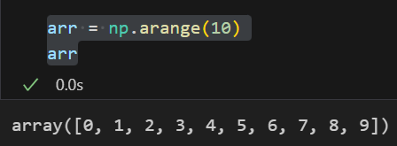
Basic Indexing and Slicing
One-dimensional arrays are the same with Python lists
> slices - views of the original array; data is not copied
> Modification reflects in the source array
Original array:
allows NumPy to work with very large data without performance and memory issues.

Slide 14
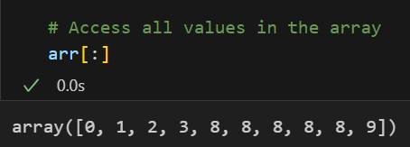
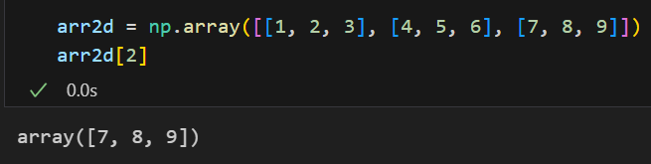
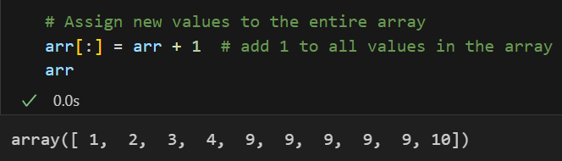
Basic Indexing and Slicing
“bare” slice [:]
all index in an array
two-dimensional array - the elements in each index are one-dimensional arrays

Slide 15
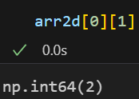
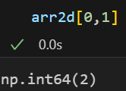
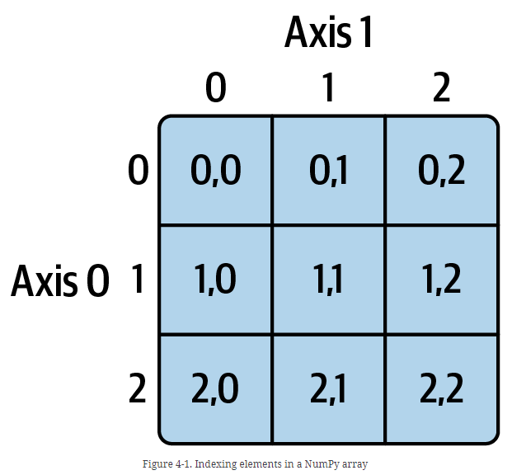
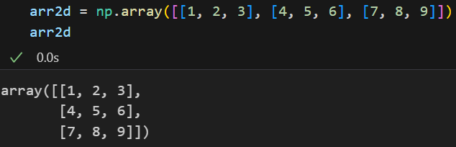

Basic Indexing and Slicing: two-dimensional array
Select the individual element using 2 ways:
$$==$$

Slide 16
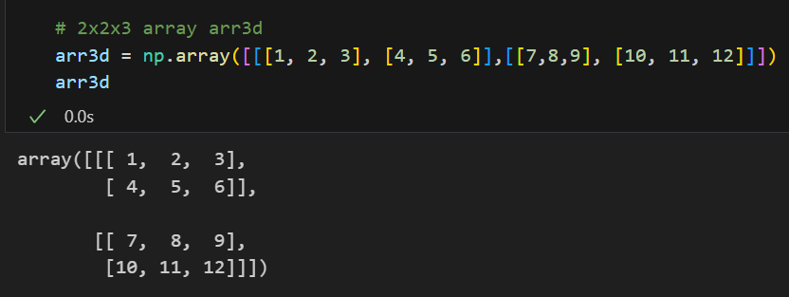
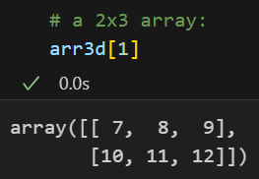
Basic Indexing and Slicing: Multidimensional array
index omitted in multidimensional arrays - returns a lower dimensional ndarray with all the data of the higher dimensions

Slide 17
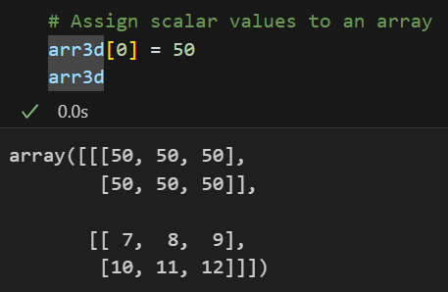
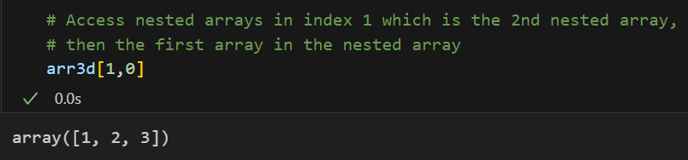
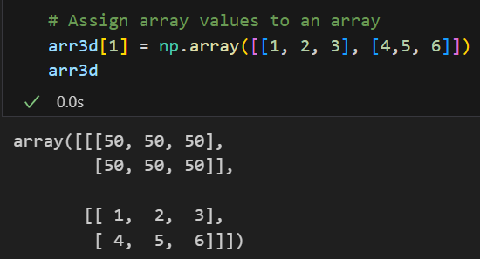
Basic Indexing and Slicing
Assign scalar values to an array
Assign arrays to an array
Access inner values in a n-dimensional array

Slide 18
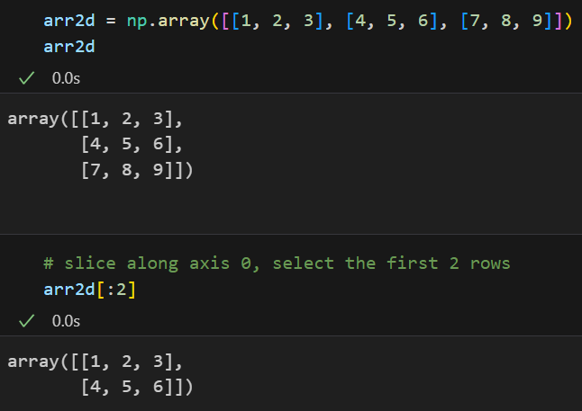
Indexing with Slices
Slicing a higher dimensional array
A slice selects a range of elements along an axis
axis 0 = the first axis = row

Slide 19
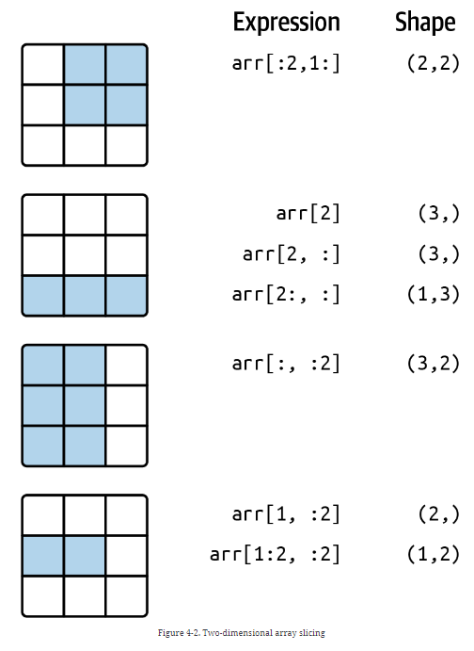
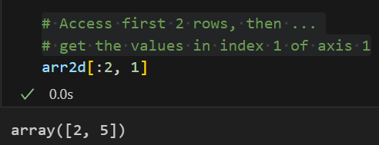
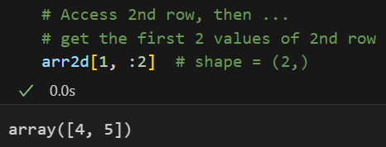
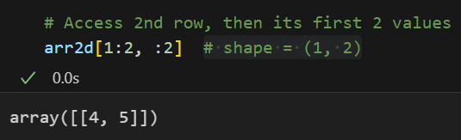
Indexing with Slices
SLICING
Output is always an array
Allows to get lower dimensional arrays

Slide 20
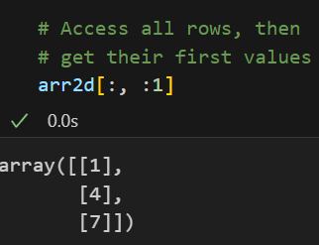
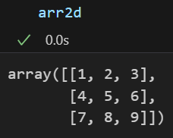
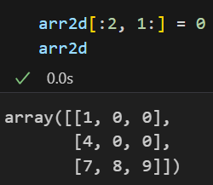
Indexing with Slices
Colon “:” - take the entire axis.
Assign a value to a slice expression.

Slide 21
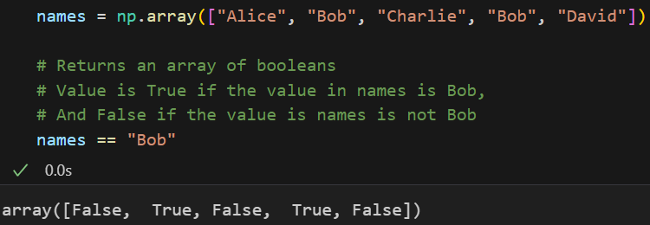
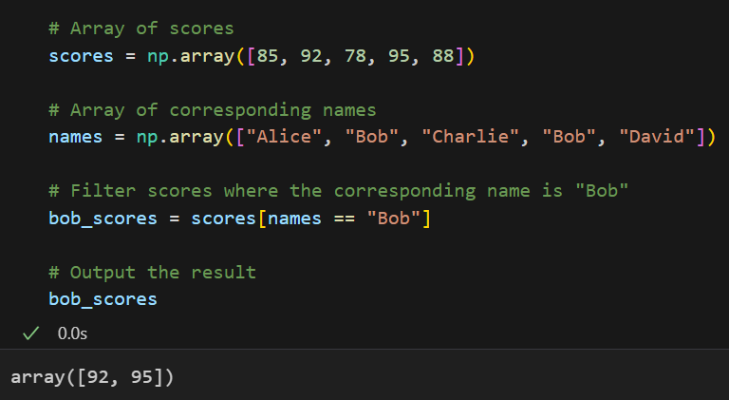
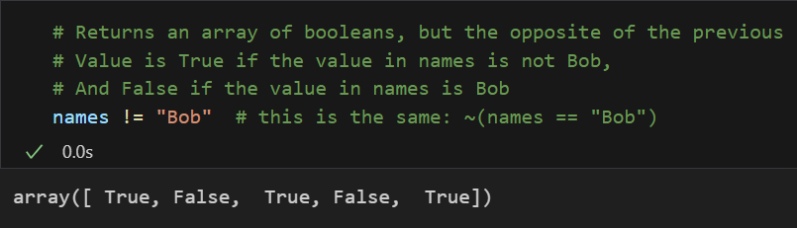
Boolean Indexing
Example: Compare each values in names with the string “Bob”
Use the comparison as condition to filter values

Slide 22
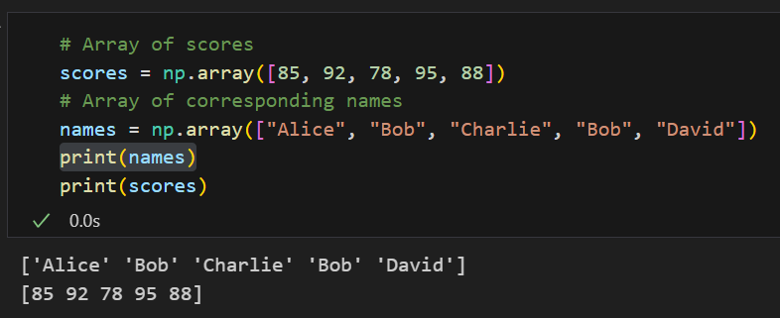
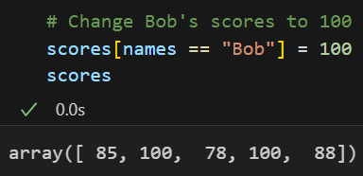
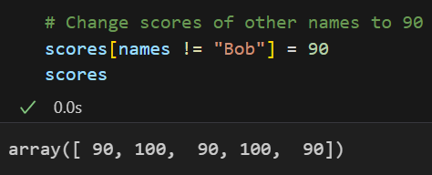
Boolean Indexing
Use the comparison as condition to filter values then re-assign values
Example: Re-assign values

Slide 23
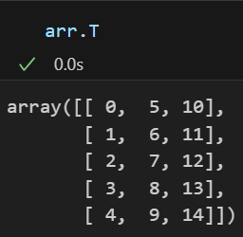
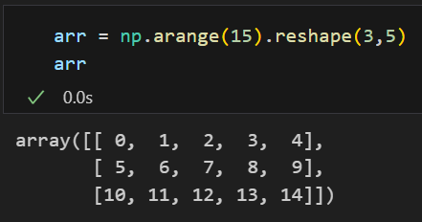
Transposing Arrays
Transposing a special form of reshaping that involves the underlying data.
How?
Transpose() method
special T attribute

Slide 24


Transposing Arrays
Useful for matrix computations like matrix multiplication using np.dot.
(Not an element-wise dot product operation.)

Slide 25

Transposing Arrays
Matrix multiplication using np.dot with transposed array

Slide 26
Universal functions: Fast Element-Wise Array functions

Slide 27



Fast Element-Wise Array Functions
Universal function or ufunc - a function that can perform element-wise operations on data in ndarrays.
Simple element-wise transformations: sqrt and exp (unary ufunc)

Slide 28



Fast Element-Wise Array Functions
Binary ufuncs - take two arrays as inputs and return a single array as an output:
maximum or add
Example: perform element-wise maximum and addition of arrays x and y.

Slide 29
Array-Oriented Programming with Arrays

Slide 30


Array-Oriented Programming
numpy.meshgrid – takes 2 1-dimension array and pair items in each array.
Example:

Slide 31

Expressing Conditional Logic
numpy.where - vectorized version of the Python’s ternary expression x if condition else y.
Example1: Take a value from x_arr if condition is True; otherwise take one from y_arr.

Slide 32


Expressing Conditional Logic
np.where version of Example 1
faster operations performance
clearer output
The second and third arguments can be scalars.

Slide 33

Mathematical and Statistical Methods
NumPy data aggregation or data reduction:
sum, mean, and std (standard deviation).

Slide 34



Mathematical and Statistical Methods
Operation can be applied to the data along an axis.

Slide 35
Linear Algebra

Slide 36

Linear Algebra
Linear algebra -an important part of any array library like matrix multiplication, decompositions, & determinants.
Use dot() for matrix multiplications

Slide 37


Linear Algebra
Get diagonal elements for a 3x3 or any square matrix (same row and column lengths)
Get inverse of X

Slide 38
Pseudorandom Number Generation

Slide 39

Pseudorandom Number Generation
numpy.random module supplements the built-in Python random function that generates arrays of sample values from many types of probability distributions.
Example: you can generate a 3x4 array of samples from the normal distribution with the mean of -2 and the standard deviation (std) of 5 using normal:
verify that the mean and std of samples are close to -2 and 5 with np.mean(samples) and np.std(samples)

Slide 40
Pseudorandom Number Generation
pseudorandom numbers
generated from an algorithm with deterministic behavior based on the seed of the random number generation.
the same ”random” sequences can be replicated by using the same seed.
np.random.seed – set or change NumPy’s random number generation seed

Slide 41
Pseudorandom Number Generation
TO DO:
1. Recreate the example from the previous 2 slides.
2. Try to generate the same sequence

Slide 42
references
references
McKinney, W. (2022). Python for Data Analysis: Data Wrangling with Pandas, Numpy, and IPython. O’Reilly. (ISBN: 1-0981-0402-1)
McKinney, W. (2022). Python for Data Analysis: Data Wrangling with Pandas, Numpy, and IPython. O’Reilly. (ISBN: 1-0981-0402-1)

Slide 43

Thank you!

